Slide 1


C# ASYNC – Await In Detail
Code It Up Online Vol. 1

Slide 2
For questions
https://sli.do #async
The YouTube Live Chat Is Not Monitored

Slide 3
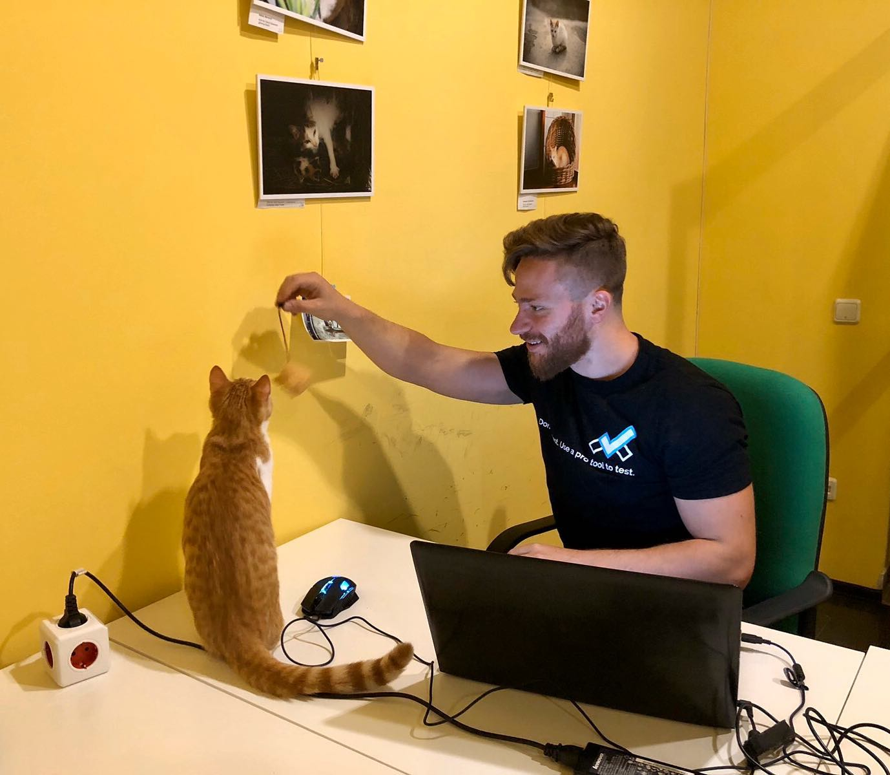
The Presenter
Ivaylo Kenov – Quality Code Advocate
Various job titles at the same time:
Organizer & Speaker @ Code It Up
CTO @ SoftUni
Full Stack Technical Trainer @ Everywhere
Code General @ https://MyTestedASP.NET
Meme Copy Machine @ Daily Programming Fun
{Insert Job Title Here}
Contacts
https://github.com/ivaylokenov
https://facebook.com/ivaylo.kenov
https://linkedin.com/in/kenov
https://www.instagram.com/ivaylokenov/
YouTube
https://youtube.com/MyTestedASPNETTV

Slide 4
What Are We Going To COVER
About Code It Up
Why Bother With Async?
From Sync to Async
Asynchronous vs Multithreaded
Task & Task<T>
The async & await Keywords
Is Async Faster Than Sync?
Gotchas & Antipatterns
Cancelling Tasks
Tasks Behind The Scenes
async & await Behind The Scenes
The New ValueTask

Slide 5
ABOUT CODE IT UP

Slide 6
Code it up
The Code It Up initiative:
Aims to provide detailed knowledge on advanced .NET topics
Aimed at people with at least 1 year of C# experience
Code It Up Online
Free live-streamed online events
Code It Up Networking
Free on-sight events with live streaming
Guest speakers from the industry
Networking part (with pizza and beer)
Code It Up Workshop
Paid events containing practical exercises for the attendees

Slide 7
Upcoming Code it up Events
Events with set dates:
May 2 – C# Multithreading Workshop
May 30-31 – DDD & Clean Architecture With ASP.NET Core Workshop
Events with no specific order or dates:
Microservices with ASP.NET Core
The Limits of the C# Runtime
API Scenarios - REST, GraphQL & gRPC
Serverless Real-Time C# Applications On AWS? Yes, It’s Possible & Easy!
C# On Rocket Fuel – Writing High Performance .NET
The ORM Wars – Entity Framework VS Dapper
Plus many more!
A SoftUni course for microservices is also in the works!

Slide 8
WHY ASYNC

Slide 9
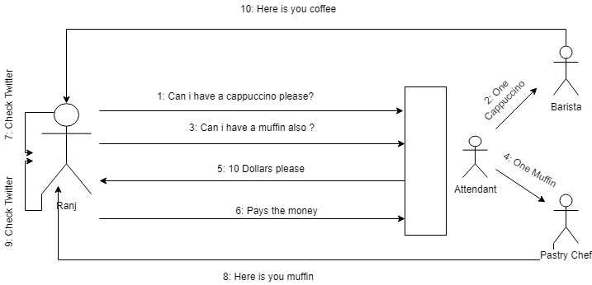
Why Bother with async programming?
Real-world example – coffee ordering

Slide 10
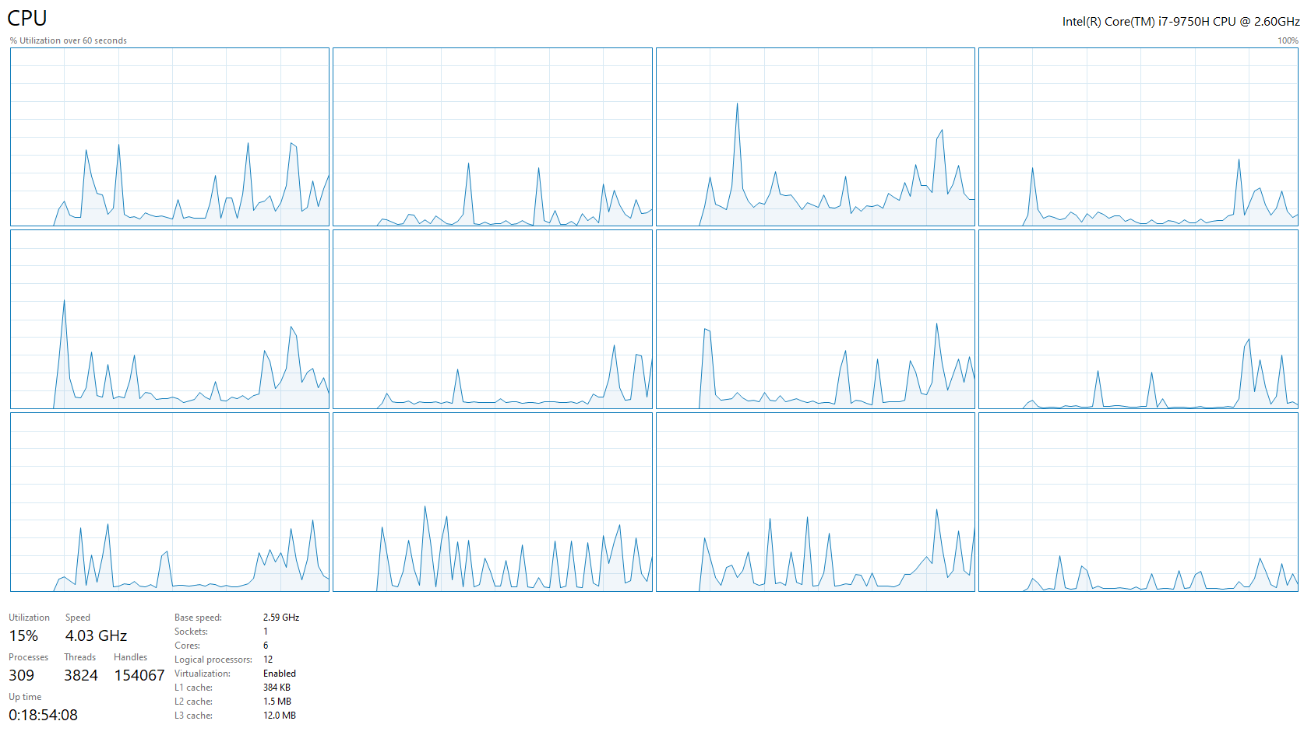
Why Bother with async programming?
Async has many pros:
Avoid unreliable applications
Improve user experience
Leverage all resources on a machine
Improve performance of CPU & IO operations
But also lots of cons:
More difficult code
More difficult to debug
Harder to understand as a concept
Too much is going on

Slide 11
FROM SYNC TO ASYNC

Slide 12
From SYNC TO ASYNC
Async code:
No longer runs line by line
Multiple operations run simultaneously
Asynchronous, in computer programming, refers to the
occurrence of events independent of the main program
flow and ways to deal with such events. These may be
“outside” events such as the arrival of signals, or
actions instigated by a program that take place
concurrently with program execution, without the
program blocking to wait for results.

Slide 13
From SYNC TO ASYNC
For example, take a look at this code:
What is the result?
Don’t be scared! Everything will be explained!
var task = Task.Run(() => Console.WriteLine("First!"));
Console.WriteLine("Second");
task.Wait();

Slide 14
DEMO

Slide 15
From SYNC TO ASYNC
Let’s cook burgers!
Pans need to be heated – 2 minutes
Meat needs to be unfrozen – 3 minutes
Potatoes need to be peeled – 2 minutes
Burgers need to be cooked – 5 minutes
Fries need to be fried – 3 minutes
Drinks need to be poured – 1 minute
All of these should be eaten! – 5 minutes
Synchronous cooker – 21 minutes in total (Slow)
All at once asynchronous cooker – 5 minutes in total (Fastest, but impossible)
Synchronized asynchronous cooker – 13 minutes in total (Fast)

Slide 16
DEMO

Slide 17
Asynchronous vs Multithreaded

Slide 18
Asynchronous vs Multithreaded
Asynchronous programming is not multithreaded programming!
These two are different programming models!
When you write asynchronous code, you don’t necessary use threads!
Back to the burgers:
Synchronous: you cook the meals one step at a time
Asynchronous: you cook the meals by doing multiple things at a time
Multithreaded:
you open a burgers restaurant
you hire a cook to make the burgers
you hire a cook to make the fries
you hire a waiter to serve the meals
you coordinate the employees so that they do not conflict with shared kitchen resources

Slide 19
Multithreading
Threading is about workers
Each thread is a separate worker
You can consider each CPU to be a separate worker
The perfect scenario is to have a thread for each CPU
In reality your OS allows you many threads and coordinates them

Slide 20
DEMO

Slide 21
Asynchronous
Asynchrony is about tasks
You assign tasks to workers
One worker may execute multiple tasks at once
Tasks are not CPU-bound by concept
A task may be put on another thread (if CPU is required), but it is not necessary
Do I need to hire a second cook, if I make burgers for myself?

Slide 22
BEFORE WE CONTINUE…

Slide 23

INDEAVR – The EVENT’s DIAMOND SPONSOR
They provide technology services focused on the Digital, Data, Cloud and Advanced Software Engineering expertise.
They are always in search for creative and passionate people with the combination of a sharp strategic mind, emotional maturity, entrepreneurial instincts, and the ability to deliver results.
https://www.indeavr.com/en/technology/application-services
https://www.indeavr.com/en/careers

Slide 24
Task & Task<T>

Slide 25
TASK
Tasks simplify working with asynchronous code
The Task class represents a void work without result
The Task<T> class returns T as a result
We create tasks with Task.Run
var voidTask = Task.Run(() => { \* Lots of work! *\ });
var resultTask = Task.Run(() =>
{
return 42; // After lots of work!
});

Slide 26
Task methods
What to do with created tasks?
Wait them to finish – blocks until the task is done
Continue with another task – chain tasks one after another
Cancel them – if the task is taking too much time
Check their state – success or faulty
Run it synchronously – don’t do that! ☺
Useful static task methods
Run – create a new task
Factory.StartNew – create a new task with advanced options
Delay – wait some time
WhenAll and WhenAny – wait for multiple tasks
FromResult and CompletedTask – finished tasks

Slide 27
DEMO

Slide 28
BEFORE WE CONTINUE…

Slide 29
Huge THANKS for your support & TRUST!
Everyone who got a paid ticket – 87 people in total! Rewards are coming!
Top supporter - Nazif - €49.99! Thank you, you crazy human!
Personal thanks to: Miroslava, Nikolay, STANISLAV, Viktor, Sinan, Desislava, Anonymous, Tanya, Yoan, Илиян, Georgi, Stefan, Nina, Maria, Ivaylo, Pavel, Valentina, Svetoslav, Ilina, Mihail, Viktor, Boris, Stoyan
Thanks also to: Venelin, Hristo, Evgeni, Rosmari, Kaloyan, Kameliya, Aleksandar, Mario, Pencho, Diana, Mariyan, Dimitar, Valentin, Николай, Tihomir, Georgi, Anton, Elena, Silviya, Petko, Georgi, Aleksandar, David, Деян, Радослав, Благовест, Hristo, Nikolay, Атанас, Nikolay, Zahari, Marin, Vasil, Mario, Dragomir, Boyan, Mariyan, Ilian, Stayko, Dobromir, Slavi, Miroslava, Martin, Adrian, Ilcho, Hristo, Ivan, pirin, Valentin, Veronika, Lyubomir, Pavel, Dimitar, Mihail, Krasimir, Цветослав, Martin, Pavel, Kristiyan, Kostadin, Hristo, Vanya, Petar, Daniela

Slide 30
These events are not Exactly free
I prefer to call them “Pay what you want”
Depending on how much you value the provided knowledge
It takes me a considerable amount of free time to prepare these lectures
And I want them to be perfect and complete!
I put my soul in them!
For this reason I will be extremely thankful, if you decide to support me and my projects!
It is never expected, but always appreciated!
The easiest way is via PayPal:
http://paypal.me/ivaylokenov

Slide 31
Mentorship program ON Patreon
These events are part of my new mentoring program!
Target – junior to regular programmers with 0 to 2 years practical work
Help with:
Becoming better software developers
Code improvement in terms of quality and logic
Career choices and advancement
Interview preparation
And more
Approach – private groups, exclusive lessons, workshops, one-on-one meetings
More information on Patreon: https://www.patreon.com/ivaylokenov

Slide 32
ASYNC & AWAIT

Slide 33
ASYNC & AWAIT
These two keywords always work together
Async methods return void, Task or Task<T>
They allow you to make Task-based code more readable
Async code looks & feels more “synchronous”
Task.Run(() => { \* Lots of work! *\ })
.ContinueWith(prev => Console.WriteLine(“Done”));
await Task.Run(() => { \* Lots of work! *\ });
Console.WriteLine(“Done”);

Slide 34
DEMO

Slide 35
.WAIT() vs await
It may look like .Wait() and await are similar, but they are not
.Wait()
Blocks the caller thread synchronously
The current thread is waiting and not doing anything
await
Does not block the caller thread
The current method is paused, and its state is captured
The caller thread is released, allowing it to do some other work
After the awaited task is completed, the caller methods continues
Always prefer the await keyword
If you need to block – use .GetAwaiter().GetResult() instead of .Wait() or .Result;

Slide 36
DEMO

Slide 37
LET’s See a performance example

Slide 38
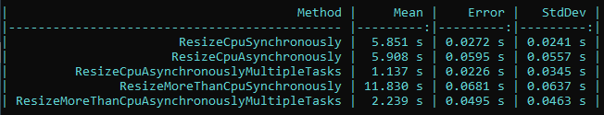
Performance example
We are going to resize images and will measure the performance
The number of CPUs images synchronously
The number of CPUs images with tasks but no .WhenAll()
The number of CPUs images with tasks by using .WhenAll()
More than CPUs images synchronously
More than CPUs images with tasks by using .WhenAll()
Don’t use tasks in non-scalable solutions! They bring overhead!

Slide 39
DEMO

Slide 40
BEFORE WE CONTINUE…

Slide 41
C# Multithreading Workshop
Held on May 2
Threads, Race Condition, Dead Lock, Thread Pool, Synchronisation and Optimization
3 hours lecture, 5 hours hands-on experience
Step-by-step exercise book about multithreading (20+ pages)
Lifetime support & Money-back guarantee
3 types of attendance
Onsight – limited seats (COVID-19 supported)
Online
Recording
http://bit.ly/ciu-multithreading

Slide 42
ASP.NET Clean Architecture Workshop
Held on May 30-31
Create a fully working ASP.NET Core application
4 hours lecture, 12 hours hands-on experience
Step-by-step exercise book about multithreading (20+ pages)
Lifetime support & Money-back guarantee
3 types of attendance
Onsight – limited seats (COVID-19 supported)
Online
Recording
http://bit.ly/ciu-ddd

Slide 43
SUPER EARLY BIRD DISCOUNT - ASYNC50
All current lecture attendees receive limited 50% discount
Use promo code ASYNC50 during checkout
The promo code is available until March 22 inclusive

Slide 44
Gotchas & Antipatterns

Slide 45
Gotchas & Antipatterns
Forgetting await
If you forget to await a task, it will simply not run as you expect causing bugs
Don’t use async void
It is fire and forget and exceptions cannot be caught
Be careful with async void lambda expressions
async Action delegates are hidden void methods
Try not to mix sync and async context
It is like trying to cook a burger with three hand while obviously have only 2… ☺
Never call .Result or .GetAwaiter().GetResult()
Always do async/await all the way down
Otherwise deadlocks may occur
If you get a deadlock, use .ConfigureAwait(false) on your tasks

Slide 46
DEMO

Slide 47
Deadlock DEMO

Slide 48
Cancelling Tasks

Slide 49
Cancelling Tasks
Some async methods can be cancelled
The method must accept a cancellation token as a parameter
You can implement cancellation in your async methods too
var cancellation = new CancellationTokenSource();
cancellation.IsCancellationRequested;
cancellation.Cancel();

Slide 50
DEMO

Slide 51
Tasks Behind The Scenes

Slide 52
Task completion source
It enables the creation of a task that can be handed out to consumers
It has helpful methods and properties:
SetResult
SetException
Task
It is useful to add async functionality to event-based APIs

Slide 53
DEMO

Slide 54
Awaiter pattern
The .GetAwaiter() method must return anything that matches this interface:
You can use the build in TaskAwaiter or TaskAwaiter<T> to for custom await implementations
bool IsCompleted { get; }
void OnCompleted(Action continuation);
TResult GetResult(); // TResult can also be void

Slide 55
Awaiter pattern
await actually works on every type having a GetAwaiter() method
You can even implement custom awaiter but most of the time it is not needed
public static TaskAwaiter<string> GetAwaiter(this Uri uri)
=> new HttpClient().GetStringAsync(uri).GetAwaiter();
var content = await new Uri("https://mytestedasp.net");

Slide 56
DEMO

Slide 57
Task SCHEDULER
The TaskScheduler class is the one who queues the tasks in your application
The default implementation uses the ThreadPool to queue and execute work
It is a pool of worker threads that are managed by the system
Maximum number of threads depend on the virtual memory
When all threads are busy, tasks are queued
The work is put on this shared queue and eventually de-queued onto the next thread that becomes available
Its algorithm is performance-oriented and does not lock by default
Top-level tasks use this global queue
Nested tasks have a local per thread queue for optimization
You can create your own TaskScheduler, if you really need it

Slide 58
Child Tasks
Tasks created in the scope of other tasks are considered child tasks
They can be attached and detached to their parent
By default they are detached by you can specify it explicitly
Attached child tasks:
Are waited by their parent to finish
Exceptions are propagated
Control the status of the parent task
Detached tasks are easier to control and thus they are recommended
By using async/await and Task.Run you don’t need to consider attaching
TaskCreationOptions.AttachedToParent

Slide 59
DEMO

Slide 60
async & await Behind The Scenes

Slide 61
The state machine
For every async method, the compiler generates a state machine
That’s an extra class (struct for release) in the final output (100 bytes)
The state machine has a MoveNext() method to change the state of the execution
Let’s decompile this async method on https://sharplab.io/
public static async Task SomeAsyncMethod(int id)
{
Console.WriteLine("Async without await" + id);
}

Slide 62
The state machine
The state machine has:
State – the state of the execution
AsyncTaskMethodBuilder to create tasks (also used by the compiler)
Initial state is -1, completed state is -2
Without an await, the state machine is pretty straightforward
Our method is also transformed:
Instantiate the method’s state machine
Create new AsyncTaskMethodBuilder and set it as state machine’s builder
Set the state machine to a starting state
Start the builder with the method’s state machine by calling the Start method.
Return the Task

Slide 63
The state machine
Now let’s add an await:
Try it with code before and after the await!
public static async Task SomeAsyncMethod(int id)
{
await Task.Run(() => {
Console.WriteLine("Async without await" + id);
});
}

Slide 64
The state machine
Now the state machine has changed
The first state is -1 so a task is created
If the task has completed synchronously, the method continues
Otherwise, the state changes and the task is registered to be executed
When the task executes, it calls again the MoveNext() method through a callback
This time the state is different, so the state machine continues after the task completion
The completed state is -2, which happens also with exceptions

Slide 65
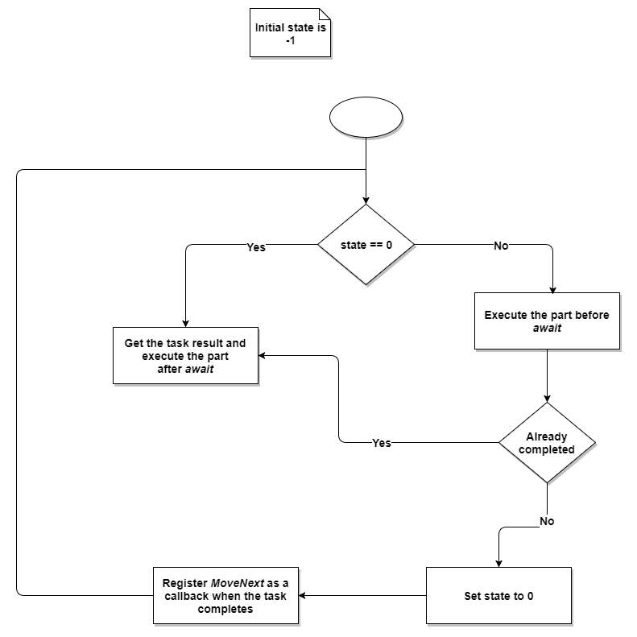
The state machine

Slide 66
The state machine
You can try it with more than 1 await to see the switch statement generated
int input = 5
await Task.Run(()=>{Console.WriteLine("First" + input);});
await Task.Run(()=>{Console.WriteLine("Second" + input);});
await Task.Run(()=>{Console.WriteLine("Third" + input);});

Slide 67
DEMO

Slide 68
The state machine
Performance improvements in the state machine
Builder reuses known tasks
Task.CompletedTask
boolean – true/false
Integers and more
But you can avoid it but removing async/await
Not by using .Wait()
But on methods which return tasks directly
There are catches though – usings, exceptions, and AsyncLocal will not work correctly
Remove async/await only on methods which are “pass through” or overloads
More information: https://blog.stephencleary.com/2016/12/eliding-async-await.html

Slide 69
Value Task

Slide 70
Value Task
The ValueTask<T> was added to .NET Standard 2.1
It is a struct so it allows less memory allocations compared to the normal Task
Can be converted to Task by calling .AsTask()
However, it should be used only after performance analysis
Tasks are the preferred approach (especially on the “hot path”)
ValueTask must:
NOT be awaited multiple times
NOT call AsTask multiple times
NOT use .Result or .GetAwaiter().GetResult() multiple times or if not completed
Because the results may be undefined (and the object already recycled)

Slide 71
BONUS – Async/Await In Web
https://github.com/ivaylokenov/MyTested.AspNetCore.Mvc/tree/development/samples/Blog

Slide 72
FINAL WORDS

Slide 73
Summary
About Code It Up
Why Bother With Async?
From Sync to Async
Asynchronous vs Multithreaded
Task & Task<T>
The async & await Keywords
Is Async Faster Than Sync?
Gotchas & Antipatterns
Cancelling Tasks
Tasks Behind The Scenes
async & await Behind The Scenes
The New ValueTask

Slide 74
Upcoming Code it up Events
Events with set dates:
May 2 – C# Multithreading Workshop
May 30-31 – DDD & Clean Architecture With ASP.NET Core Workshop
Events with no specific order or dates:
Microservices with ASP.NET Core
The Limits of the C# Runtime
API Scenarios - REST, GraphQL & gRPC
Serverless Real-Time C# Applications On AWS? Yes, It’s Possible & Easy!
C# On Rocket Fuel – Writing High Performance .NET
The ORM Wars – Entity Framework VS Dapper
Plus many more!
A SoftUni course for microservices is also in the works!

Slide 75

ANY QUESTIONS?
You can support me and my projects:
Via PayPal: http://paypal.me/ivaylokenov
On Patreon: https://www.patreon.com/ivaylokenov
On Open Collective: https://opencollective.com/mytestedaspnet
Via Buy Me A Coffee: http://buymeacoff.ee/ivaylokenov
Crypto: http://bit.ly/ik-sponsors
The T-Shirts are ready and will be shipped next week!
Never expected, always appreciated!

Slide 76
Thank You!
Code and presentation available here: https://github.com/ivaylokenov/C-Sharp-Async-Await-In-Detail

